Slide 1


CYTOAUTOCLUSTER: A SEMI-SUPERVISED DEEP APPROACH FOR CYTOMETRY DATA ANALYSIS
-AKSHAYA V

Slide 2
INTRODUCTION
OBJECTIVE :
To handle high-dimensional cytometry data, preprocess the information efficiently and conduct thorough analysis to extract meaningful insights. Develop innovative semi-supervised clustering methods tailored to the unique characteristics of the dataset. Finally, perform validation by comparing the output clusters to manually gated clusters, ensuring reliability and accuracy.
KEY INSIGHT:
Cytometry data analysis is essential for decoding immune system profiles and discovering biomarkers.
The project investigates semi-supervised clustering methods to handle the complexities of this analysis.
Techniques like autoencoder-based feature extraction are employed to enhance clustering efficiency.

Slide 3
DATASET OVERVIEW
CHARACTERICTIC | DETAILS
Cells (n) | 265,627
Markers (p) | 32
Manually Labeled Cells | 39% (104,184 cells)
Clusters (k) | 14
Unlabeled Cells | 61%(161,443 cells)

Slide 4

PROBLEM STATEMENT
High-dimensional cytometry data is challenging to analyze due to its complexity and noise.
Traditional clustering techniques often fail to provide accurate or meaningful insights.
There is a need for advanced methods like semi-supervised clustering and autoencoder-based feature extraction to improve data representation and clustering accuracy.

Slide 5
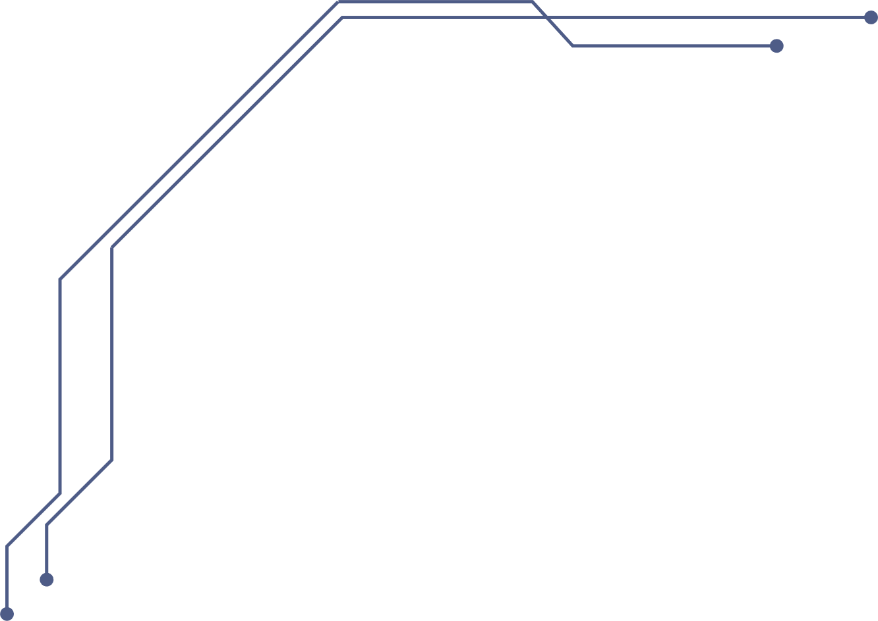
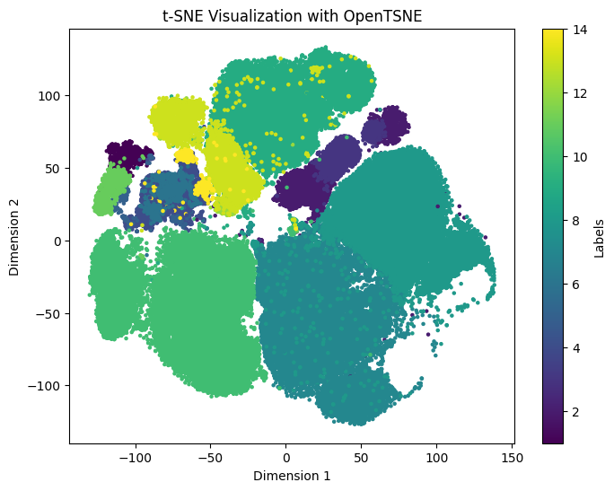
METHODOLOGY
PREPROCESSING
Data normalization and exploratory analysis
Handling partially labeled datasets
CLUSTERING TECHNIQUES
Use autoencoders to reduce the dimensionality of high-dimensional data.
Apply t-SNE to visualize the reduced data in a meaningful way.
Identify clusters within the visualized data for better insights.
TSNE Before Encoder Implementation

Slide 6
VIME Model: Variational Information Maximization Embedding model
Purpose:
Combines labeled and unlabeled data to improve performance in tabular datasets.
Key Steps:
Pretext Task: Self-supervised learning with attribute masking & reconstruction.
Fine-Tuning: Uses labeled data for specific tasks (e.g., classification).
Advantages:
Handles limited labeled data effectively.
Robust for tabular data where deep learning often struggles.
Reduces overfitting risks.

Slide 7

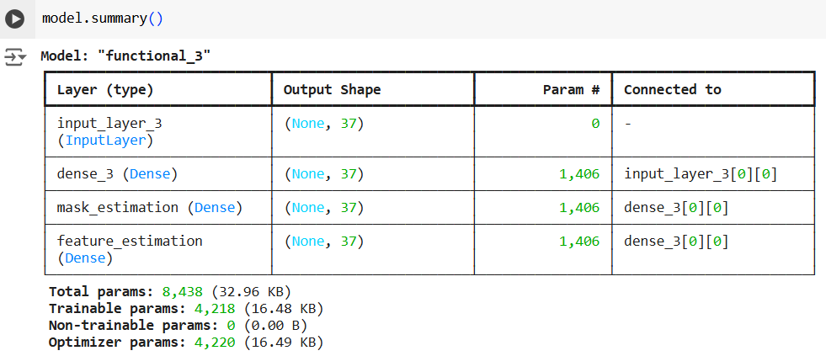

MODEL ARCHITECTURE AND IMPLEMENTATION
1.Semi-Supervised Learning:
Use self-supervised encoders to extract meaningful features from the data.
Perform supervised fine-tuning with models like logistic regression and XGBoost.
2.Training Details:
Configure training parameters such as batch size,
number of epochs, and optimization techniques.
Address class imbalance by incorporating
weighted loss functions.

Slide 8
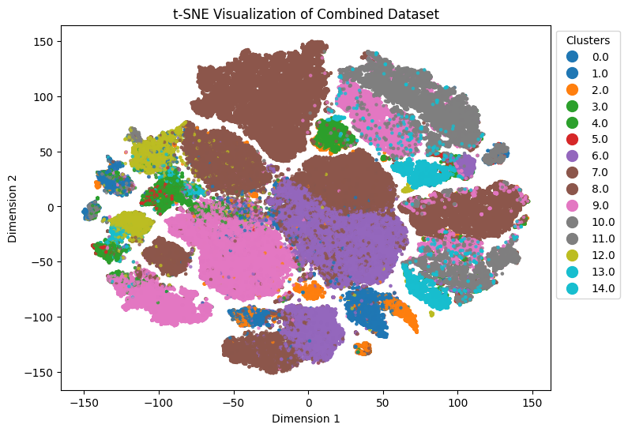

RESULTS AND EVALUATION
Quantitative Metrics:
Logistic Regression Log Loss: 0.02165
XGBoost Log Loss: 0.04685
Self-Supervised Model Accuracy: 97.60%,
AUROC: 99.93%
Visual Insights:
t-SNE plot showcasing cluster separation
TSNE After Encoder Implementation

Slide 9
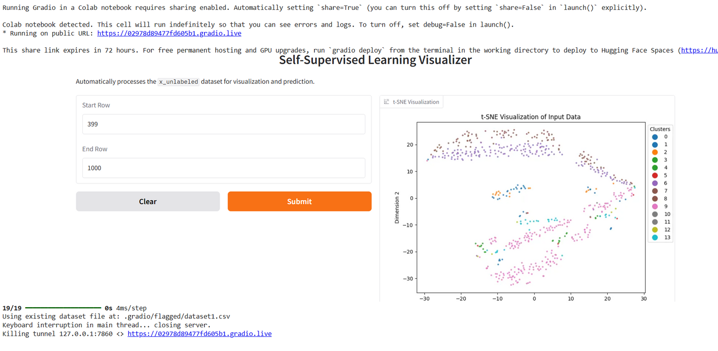
GRADIO INTERFACE FOR USER INTERACTION
Features:
Utilize t-SNE to create visual representations of selected data subsets.
Dynamically infer and classify cell types based on the input data.
Key Functions:
Processes unlabeled data by extracting
meaningful features.
Produces both predictions and visual representations for better interpretation.

Slide 10
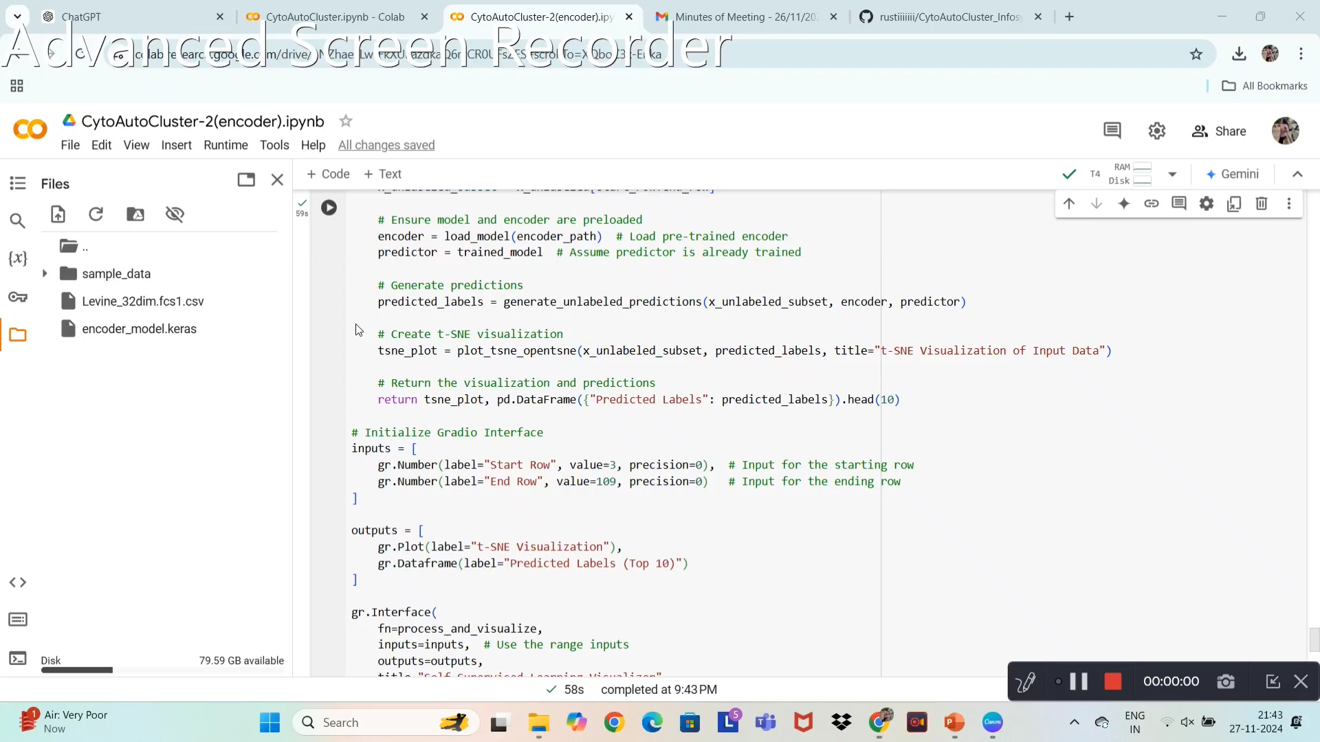
IMPLEMENTATION DEMO VIDEO:

Slide 11
THANK YOU
- AKSHAYA V

